Slide 1
Impact of the CPT monitoring on the treatment of persons deprived of their liberties
Erinda Bllaca
Albanian Rehabilitation Centre for Trauma and Torture

Slide 2
ARCT is:
Albanian Rehabilitation Centre for Trauma and Torture (ARCT) represent a small piece of the Albanian civil society organizations: it is a non-profit, non-political and non-governmental organization operating in Albania since 1994, designing and implementing programs that support the rehabilitation of torture victims (existing and new) and the prevention of torture
Email: arct@albmail.com
Website: http://www.arct.org
ARCT, Albania

Slide 3
How the CPT was presented in Albania
Albania has ratified the ECPT since 1996.
First visit by the CPT was paid by the end of 1997, after the Convention entered into force
Only in 2001, the Albanian authorities understood the important role that the CPT was playing with regards to the “treatment of the persons deprived of their liberties …the protection of such persons from torture and from inhuman or degrading treatment or punishment”.
ARCT, Albania

Slide 4
How the visits started to improve the standards regarding deprivation of liberty
Although with no mandatory status, the CPT visits have always “shaken” grounds:
  The independency, confidentiality, multi-professional representation, and the direct language in recommendations put the Albanian state authorities in the situation where urgent change was needed
ARCT, Albania

Slide 5
Responses from the Albanian authorities:
  Albanian Govt. decided to make public the CPT reports since early 2000
  The transfer of the pre-trial detention facilities happened in late 2007
  Authorities introduced a system of regular and up-to-date information on the use of complaints mechanisms
  The Ministry of Justice developed a Master Plan with regards to the improvement of 19 detention facilities, and opening of 5 new places of detentions.
ARCT, Albania

Slide 6
Responses from the Albanian authorities:
  Albanian Police directorate in 2010 closed more than 45 police lock-ups.
  Changes in the primary and secondary legislation with regards to the treatment of persons deprived of their liberties (2010, 2012, 2014)
  A joint MoU between the MoJ and MoH with regards to forensic services was initiated in 2010
  The “Prevention of Torture “ and “fight against impunity” was widely introduced as part of independent prison oversight
ARCT, Albania

Slide 7
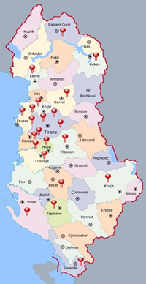
Prisons and Pretrial detention facilities
Prisons:
Ali Demi (325)/Tirana
Jordan Misja (313) /Tirana
Vaqarr, /Tirana
Peqin
Burrel
Special Institution, Krujë
Fushë-Krujë
Korçë
Lezhë
Tepelenë
Rrogozhinë
Lushnjë
Correctional Juvenile Centre of Kavaja
Pretrial Detention:
Elbasan
Prison Hospital
Mine Peza (302)
Durrës
Kukës
Fier
Tropojë
Berat
Vlorë
Sarandë
Prison population is 5850, out of the official capacities of 3800 inmates.
ARCT, Albania

Slide 8
Police Holding Cells:
General District directories (12)
Police commissariats (21)
Police stations (14)
Border police units (8)
A special centre for asylum seekers
A special detention centre for illegal refugees
ARCT, Albania

Slide 9
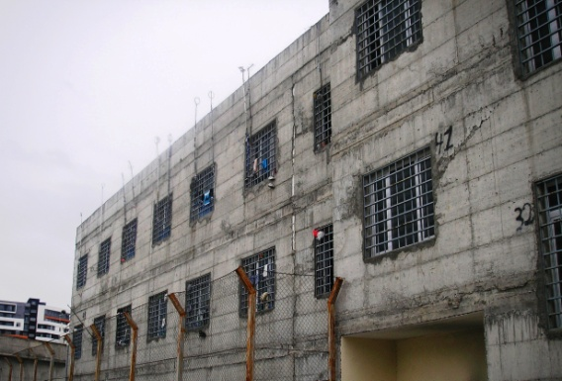
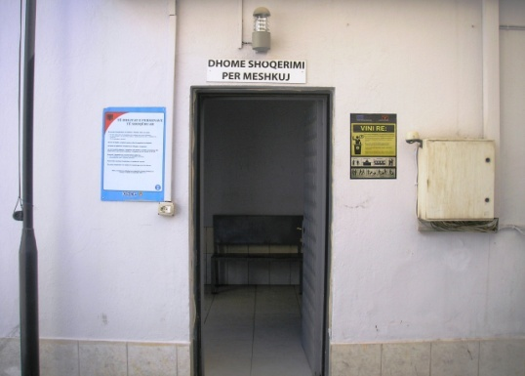
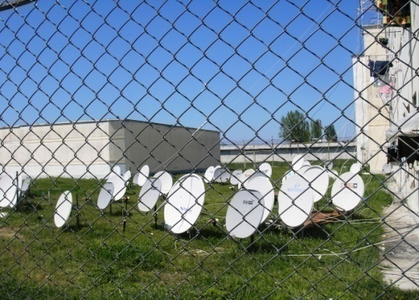
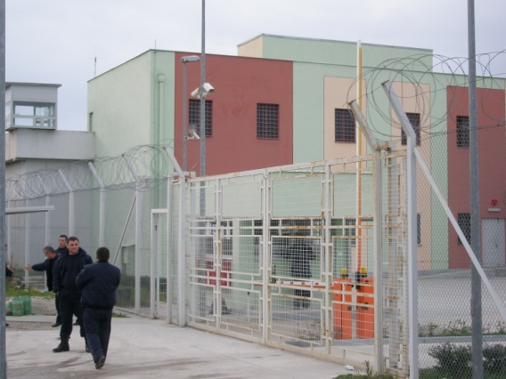
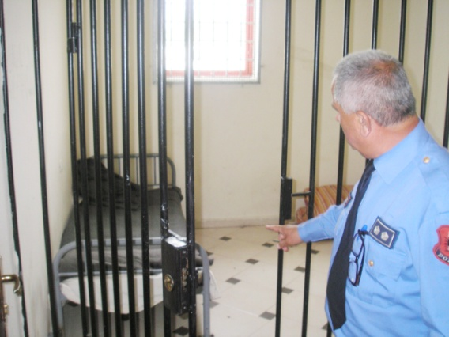
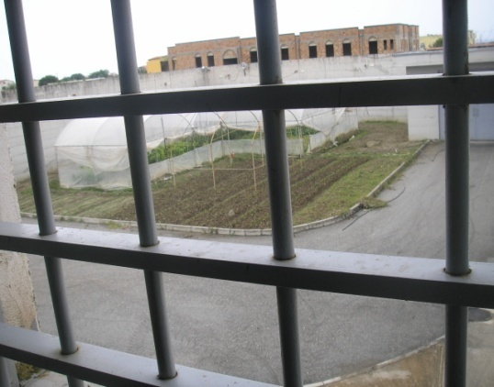
Prisons as seen by ARCT monitors:
Durres PTD
Rrogozhina Prison
Lezha Prison
Vlora PTD
Fier Police Commissariat
Juvenile Correct.Centre

Slide 10
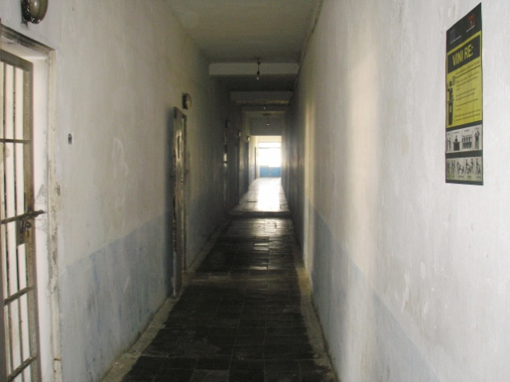
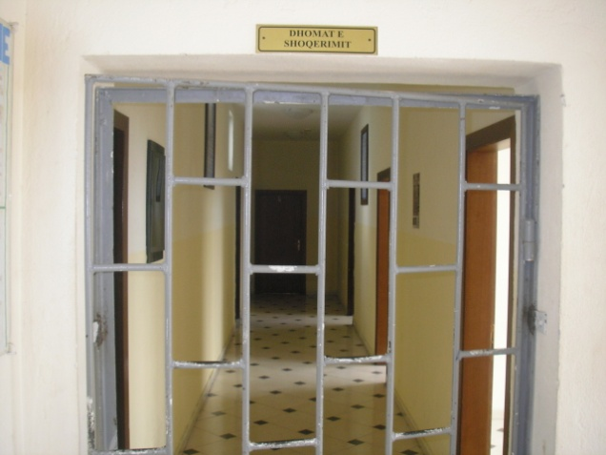
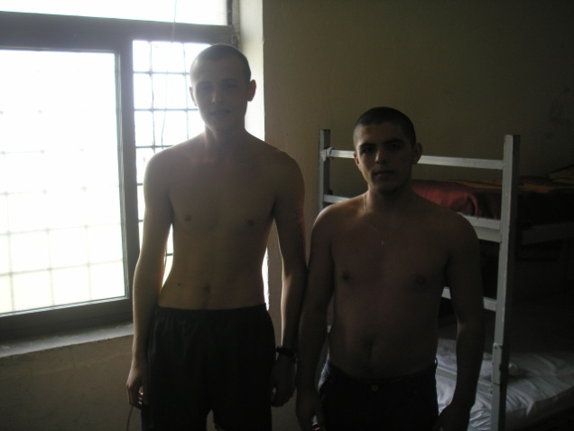
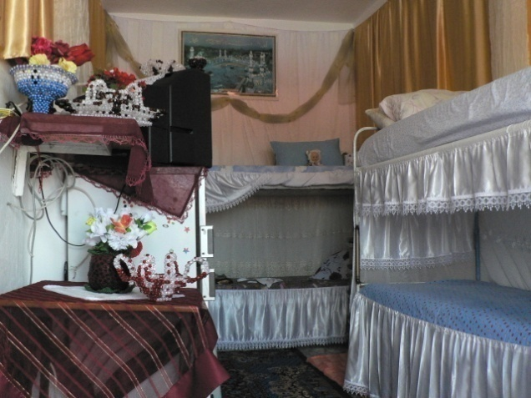
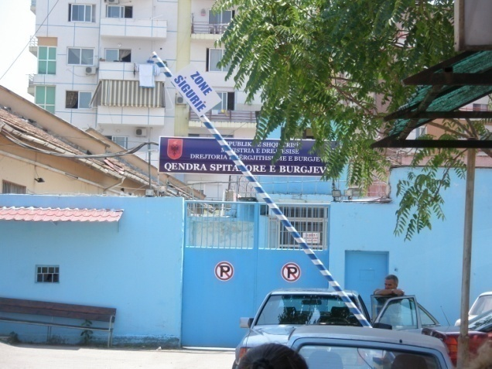
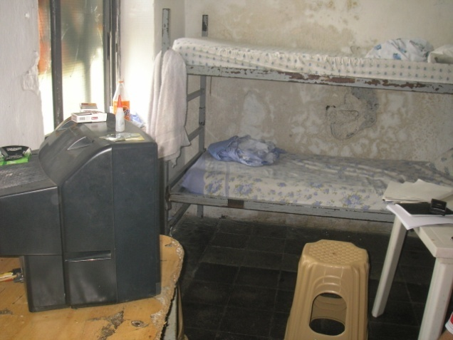
Prisons as seen by ARCT monitors:
Fushe-Kruje Prison
Police Commissariat 2, TR
Juvenile offenders
Women Prison Cell
Prison Hospital, Tirana
Lezha Prison Cell

Slide 11
In the discourse of the preventive role of the CPT visits:
  What was well accepted :
    The unified methodology in the monitoring,
    The broad scope of the mandate
    The access to places of detention
    The confidential interviews with inmates …
    Such role started the National Campaign against Torture – and the process for the ratification of OPCAT/ establishment of the NPM
ARCT, Albania

Slide 12
What can CPT add to specific issues related to specific countries monitored ?
Albania has inherited very old prisons from the communist regime, where the detentions were beyond imagination, and torture and ill treatment would have challenged even the Kallashnikov Case …
  CPT has clearly articulated the appalling conditions in all high security prisons which belonged to previous regime in Albania
Our main dilemma:
How to approach the torture survivors of previous communist regime– and why this issue remains out of the CPT mandate… when torture is non derogible and universally prohibited

Slide 13
Cooperation of the CPT with local NGOs:
The today’s monitoring practices show that civil society actors have embodied the CPT monitoring standards
  As part of their ongoing process of the regular and periodic monitoring,
  Regarding access to places of detention
  Periodic Data collection
  As opportunity to measure the changes and the development..
  NGOs can challenge the culture of impunity with respect to ill-treatment in detention
ARCT, Albania

Slide 14
What OPCAT changed/added for Prevention:
In 2006, Albania ratified OPCAT, and 2010 civil society lobbied with the Legislative and Executive to have it as part of the AP (a unit)
EU strongly encouraged cooperation with professional and knowledge-based NGOs and other watchdog organizations, active in detention monitoring (MoUs)
Dedicated, regular detention monitoring / as a preventive measure
ARCT, Albania

Slide 15
Instead the practice shows a different picture:
  An NPM, which does not provide a differentiated model of mandates, purposes and powers, with regards to the type of other AP inspections
  Dependant to AP for the resources and staff
  Non- acknowledgement of the civil society as part of the NPM, but rather preferential and as a “hired” expertise
  No comprehensive monitoring methodology or visit schedule developed – to ascertain the periodicity
ARCT, Albania

Slide 16
What remain to discuss :
What if NPM does not fully apply the OPCAT requirements? How the independence should be maintained? Who controls the performance of NPM and what if fails? What makes the Sub Committee active in practice?
Specific expertise of NGO – rather than targeted as “spies” of international community, what is the added value with regards to the protection of basic rights of detainees?
The mandate - how to protect the information gathered by NGOs, and how to avoid overlapping
ARCT, Albania

Slide 17
CPT & NGOs:
How joint cooperation between NGOs and the CPT can ensure better documentation of violations as well as advocacy.
In what fields could this cooperation be improved?
How could the NGO sector contribute more and how could the CPT help the NGO sector more in reaching their goals?
ARCT, Albania

Slide 18
Thank you for your attention
Albanian Rehabilitation Centre for Trauma and Torture
arct@albmail.com

